Slide 1
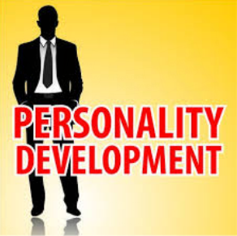

Slide 2
Personality Development
Personality – Latin Word - Persona - Mask
Every Person - Wisdom - Behavior - Skill
Love - Values = Personality

Slide 3
Skill - Wisdom
Optimist - Pessimist
Don’t Live ‘For’ Happiness. Live ‘with’ Happiness

Slide 4
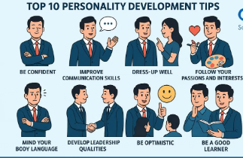

Slide 5
Great Personality,
Mahatma Gandhi,
Nelson Mandela,
Shania Twain ,
Mother Teresa

Slide 6
B - Basic Quality, (Good, Excellent, Bad)
R - Reputation,
A - Achievement,
N - Network,
D - Dignity,
Love
Respect

Slide 7
ಯಶಸ್ಸಿನ ರಹಸ್ಯವು ರಹಸ್ಯವಲ್ಲ. "ನೀವು ಯಾವುದೋ ಒಂದು ದೊಡ್ಡ ಉದ್ದೇಶದಿಂದ ಪ್ರೇರಿತರಾದಾಗ, ನಿಮ್ಮ ಆಲೋಚನೆಗಳು ಅವುಗಳ ಬಂಧಗಳನ್ನು ಮುರಿಯುತ್ತವೆ, ನಿಮ್ಮ ಮನಸ್ಸು ಮೀರುತ್ತದೆ; ನಿಮ್ಮ ಪ್ರಜ್ಞೆಯು ಎಲ್ಲಾ ದಿಕ್ಕುಗಳಲ್ಲಿಯೂ ವಿಸ್ತರಿಸುತ್ತದೆ ಮತ್ತು ನೀವು ಎಂದಾದರೂ ಆಗಬೇಕೆಂದು ಕನಸು ಕಂಡಿದ್ದಕ್ಕಿಂತ ಹೆಚ್ಚಿನ ವ್ಯಕ್ತಿಯಾಗಿದ್ದೀರಿ ಎಂದು ನೀವು ಕಂಡುಕೊಳ್ಳುತ್ತೀರಿ"
ಪತಂಜಲಿ.

Slide 8
Great people learn by other's experience. Average people learn by their own experiences and stupid never learns.
An effective leader radiates positive energy. He is cheerful,

Slide 9
Correct expression is an art. See this expression: "We have gone through your application which was sent by you two weeks back in which you requested for a job and we, as we do not have any vacancies in our organization, are sorry to inform you that we are unable to provide any job to you at present, but you may approach us after six months, as your qualification and experience suits us."

Slide 10
The same can be expressed in this way: "We are happy to receive an application for a job from you. We regret to inform you that at present we do not have any vacancies. But we are impressed with your qualification and experience. We request you to approach us after 6 months".

Slide 11
LEARNING PROCESS
Newton observed an apple, falling down from a tree. He questioned himself, 'why should it fall on earth?" He thought and experienced the answer and discovered the force of gravitation. He became 'Sir' Isaac Newton. This is wisdom. A person derives his wisdom through six sources.

Slide 12
1. Shabda (Listening)
2. Drishya (Seeing)
3. Parisheelana (Observing)
4. Anumana (Questioning)
5. Anubhava (Experiencing)
6. Yochana (Thinking).

Slide 13
Skill is different from wisdom. Fighting with a lion may be a skill. Not fighting unnecessarily is "wisdom". Skill, added with experience, emotion with balance of mind, intelligence coupled with knowledge... in total is called wisdom (Jnana).

Slide 14
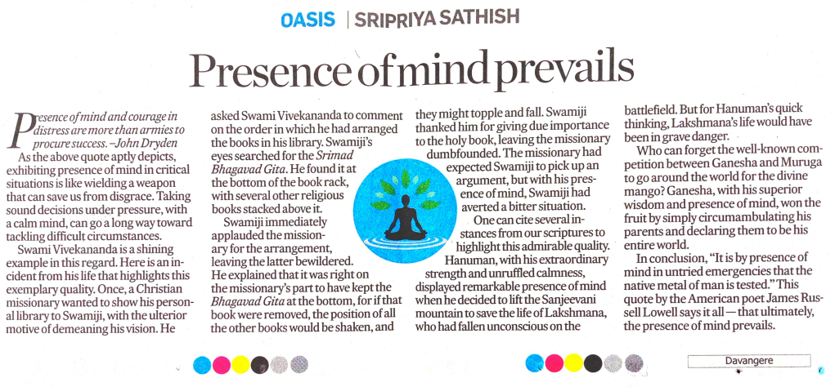

Slide 15


Slide 16


